Slide 1
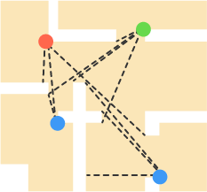
The Art Gallery Problem
Discrete Mathematics - Project
Group Members: Abdullah Amir
Hamza Ansari
Musab Kasbati
Muhammad Anas

Slide 2
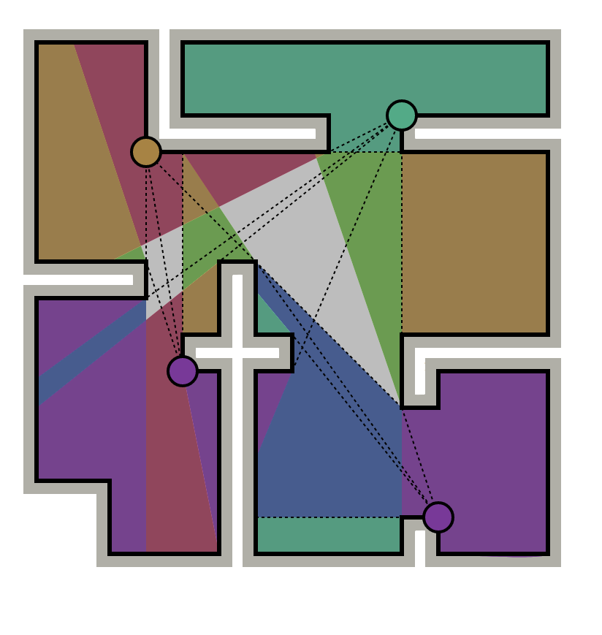
We want to secure the premises of an expensive art-gallery
Using 360° vision CCTV cameras
While minimizing the number of cameras
Notes:
Before moving on, mention that this problem isn’t specific to just art galleries and is important to many other scenarios. We can abstract this away to get the problem statement [next slide]

Slide 3
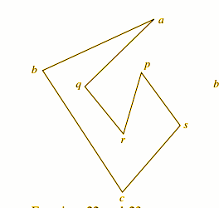
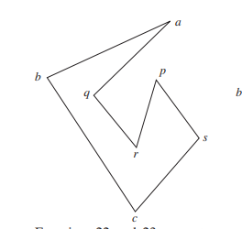
Problem Statement
The art gallery problem asks the minimum number of guards that need to be placed in an n-vertex simple polygon such that all points of the interior are visible. A simple polygon is a connected closed region whose boundary is defined by a finite number of line segments. Visibility is defined such that two points u and v are mutually visible if the line segment joining them lies inside the polygon.

Slide 4
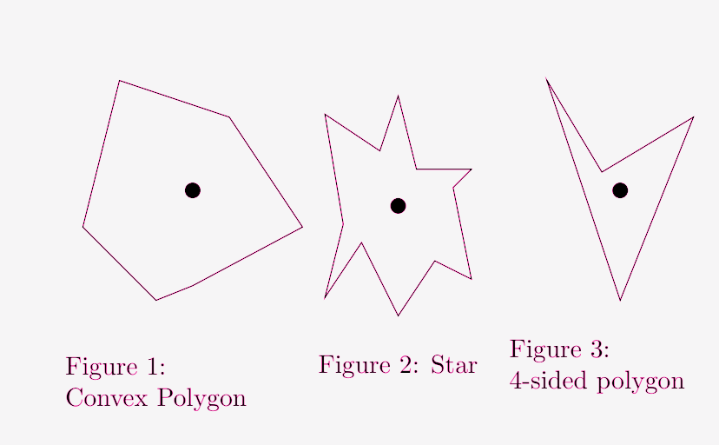
Secure the Art Gallery
Consider the simple polygon
Every angle <=180°
One Camera is enough for monitoring the whole premises.
CCTV

Slide 5
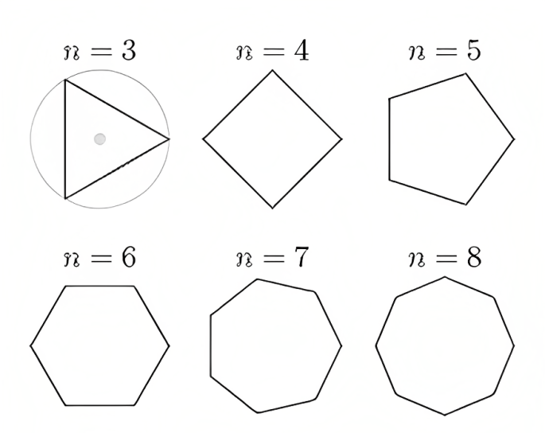
CASES OF CONVEX POLYGONS

Slide 6
BUT
WHAT ABOUT SOME COMPLEX SHAPES OF ART GALLERIES ??

Slide 7
To speak more generally
We need a system to help us talk about visibility

Slide 8
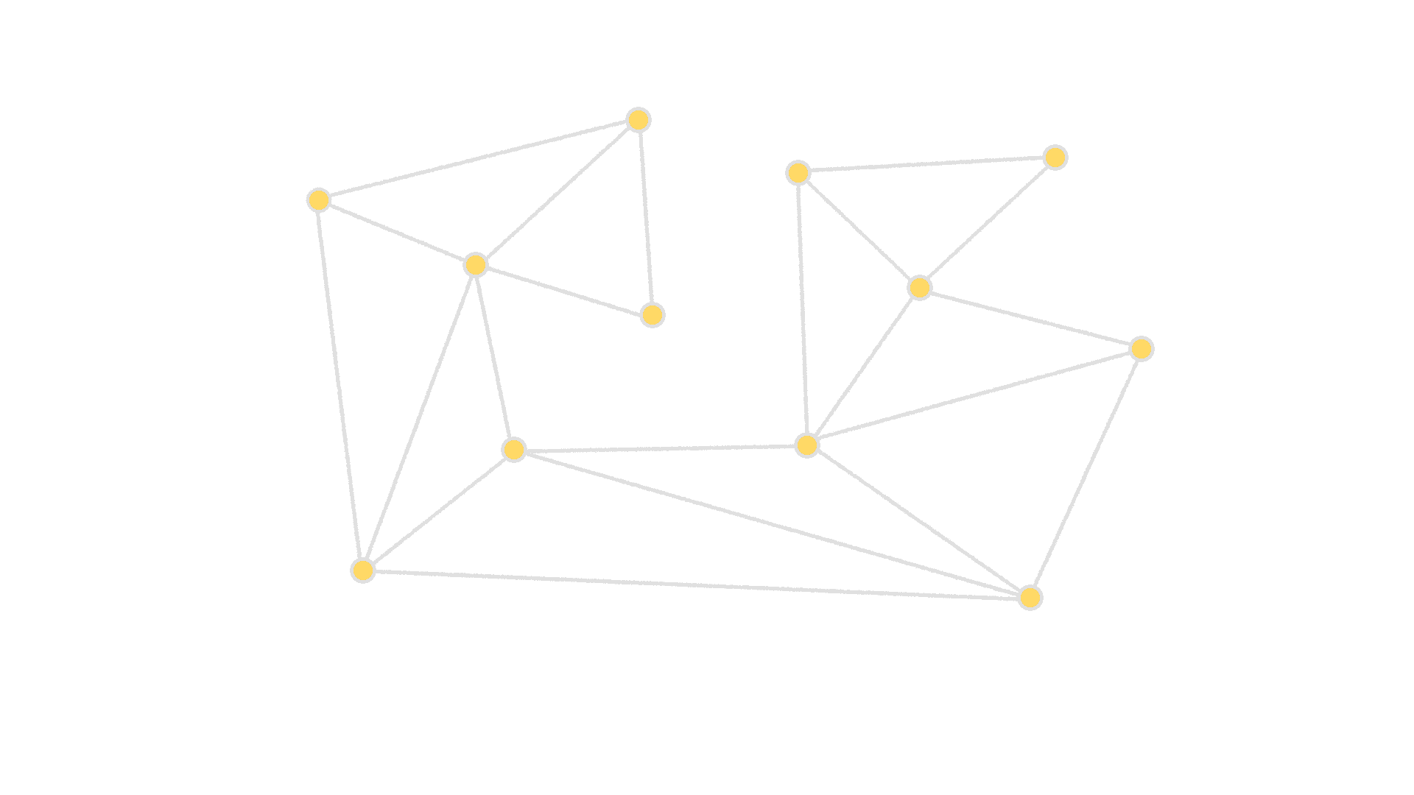
Triangulation

Slide 9
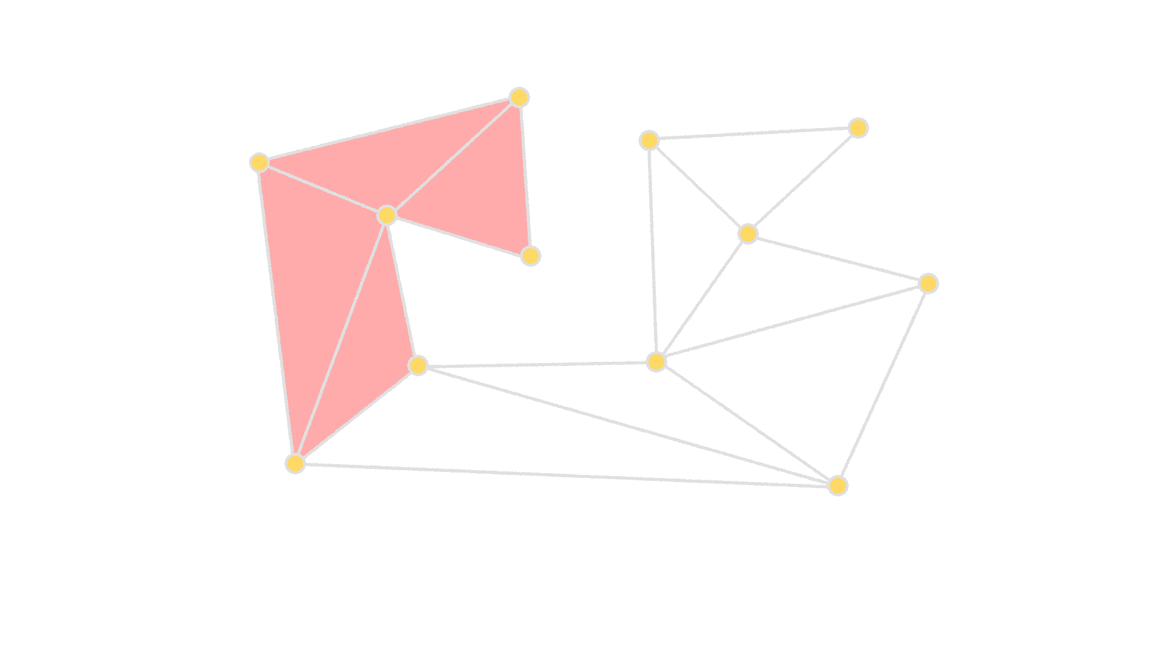
Triangulation

Slide 10
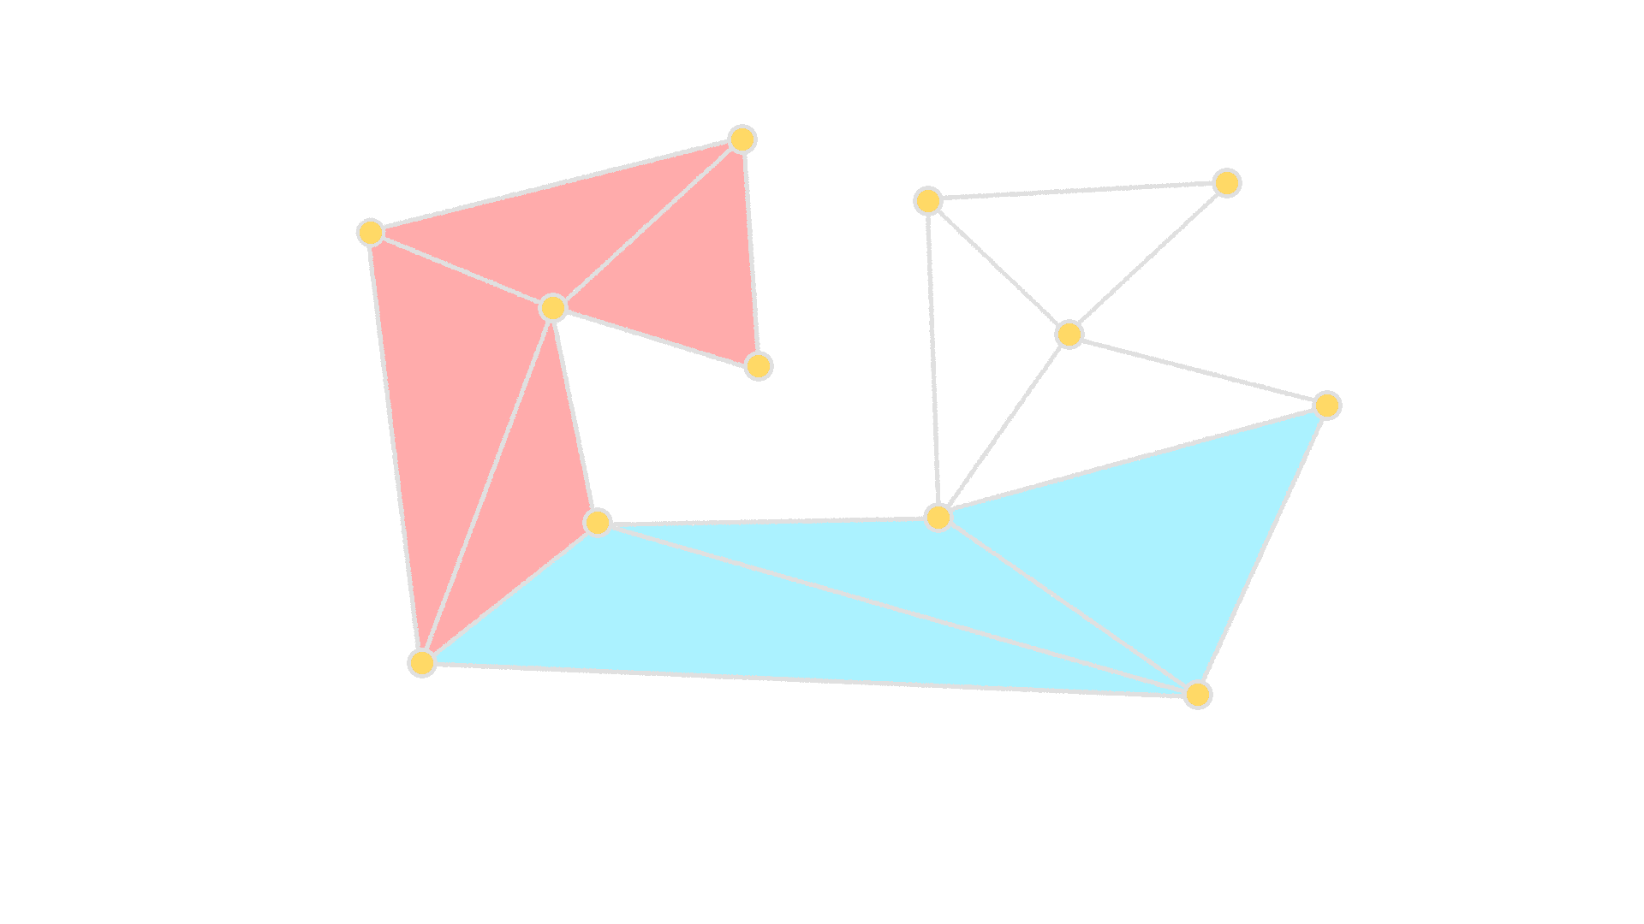
Triangulation

Slide 11
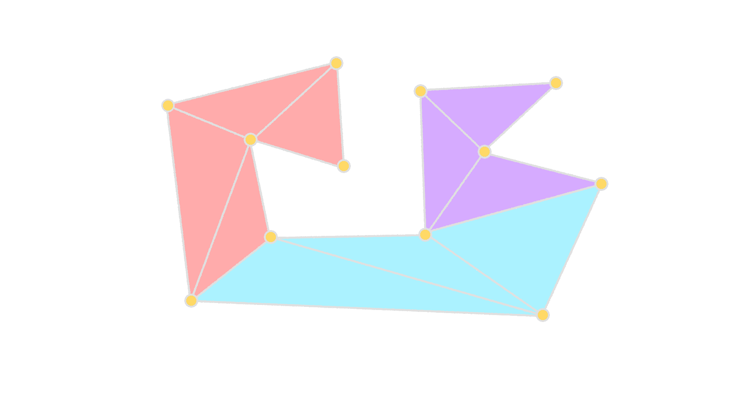
Triangulation

Slide 12
So how are we going to triangulate the polygon?

Slide 13
By Induction!

Slide 14
But first what is triangulation?
Triangulation is a process in computational geometry which involves dividing a simple polygon into triangles by adding non-intersecting diagonals.

Slide 15
Base Case
Well, firstly we assume that a triangle is itself already triangulated
This is the trivial (or base) case for triangulation

Slide 16
Induction Hypothesis
Polygons with upto k sides can be triangulated.
But how do we triangulate polygons with more than 3 sides?

Slide 17
Now for polygons with more than 3 sides, to triangulate them we’ll try to break them into smaller polygons
To do that we need:
A convex vertex (which will always exist in a polygon)
2. A diagonal that will connect two neighbours of the convex vertex
This vertex here is convex

Slide 18
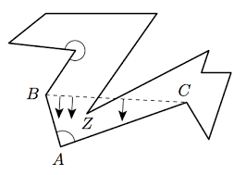
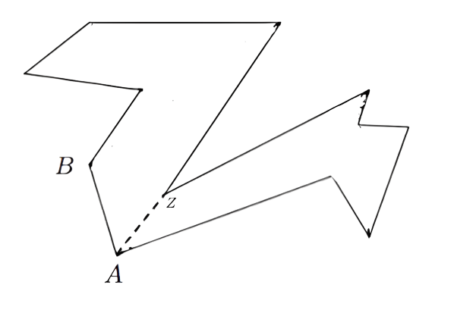
When drawing the diagonal, we need to make sure that it lies inside the polygon.
If part of it goes outside the polygon, then we slide it down towards the convex vertex until it reaches a new vertex
The convex vertex is then connected to this new vertex by a line.
this becomes

Slide 19
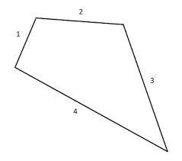
Now equipped with these two tools of triangulation, we will use induction to prove that any polygon can be triangulated.
We start off with polygons of 3 sides
We know from the trivial case that all 3 sided polygons or triangles are triangulated, so we have already proven this case.
Next, when the number of sides is 4, we can draw a diagonal to triangulate the polygon.

Slide 20
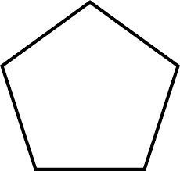
Similarly, in case of 5 vertices, a polygon may be triangulated as follows:
Since we already showed that polygons 4 sides are triangulated, this 5 sided polygon also gets triangulated.
3
4

Slide 21
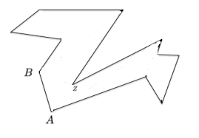
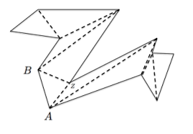

Following this procedure, we can see that every (k+1)-sided polygon is triangulated into polygons with sides < k+1, which are further triangulated until the base case is reached.
In this way any polygon can be triangulated:

Slide 22
So, How many Guards are required to secure the Art Gallery?

Slide 23
For instance, let’s consider the following polygon with 10-vertices.
If we place a guard at every one of the vertices then it would be safe to say that the entire gallery is protected
Hence, for a polygon with n vertices, n guards (at most) are required

Slide 24
However, this is a bit excessive. Don’t you think that too?
It turns out that a well known upper limit that we will be proving today is that in the Worst case scenario N/3 (round down) guards are required to guard the gallery.
Note: We will only be placing guards at the corners
N=10
⌊N/3⌋=3
Hence, 3 guards is all we need to observe this entire gallery

Slide 25
However, you would notice that the green and red guards are enough to guard the gallery since everything that the yellow guard sees is also visible to the red guard, making him unnecessary. (Shouldn’t this be on the previous slide since this has nothing to do with this diagram?)
Consider the shape below, also with 10 vertices.

Slide 26
We cannot make our general theorem any stronger because of shapes like these
Green Guard’s vision Red Guard’s vision Blue Guard’s vision
Because of the non-overlapping region in Guard’s vision( represented by the purple area) which is not common to any 2 guards, we need at least 3 guards to safeguard this gallery

Slide 27
In order to prove that this formula holds, we need to prove two things:
Prove that any polygon can be triangulated
In simpler words, we have to prove that a polygon can be broken down into triangular regions with internal non-intersecting line segments. Any guard placed at one of the corner can see (at least) the areas covered by the triangles sharing that vertex

Slide 28
2) Prove that any triangulated polygon is 3-colorable
This means that we have to prove that we can label every vertex using only 3 colors in such a way that no two connected vertices are of the same color

Slide 29
Next, how will we make our polygon 3-colourable?

Slide 30
By Induction!
(again)

Slide 31
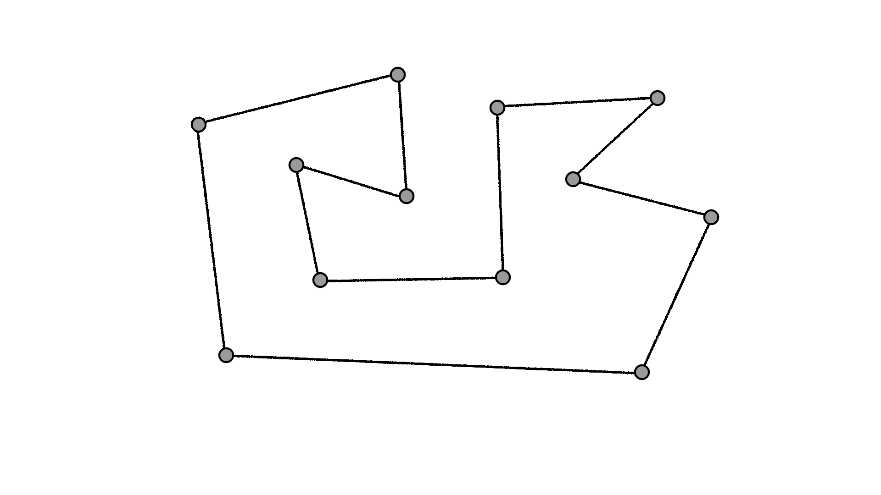
But first, what does it mean to be 3-colourable?
Notes:
a polygon is 3 colorable, if it can be completely broken down into triangles, and the vertices of a resulting shape can be assigned a colour in such a way that no 2 vertices with the same colour are connected by an edge of a triangle

Slide 32
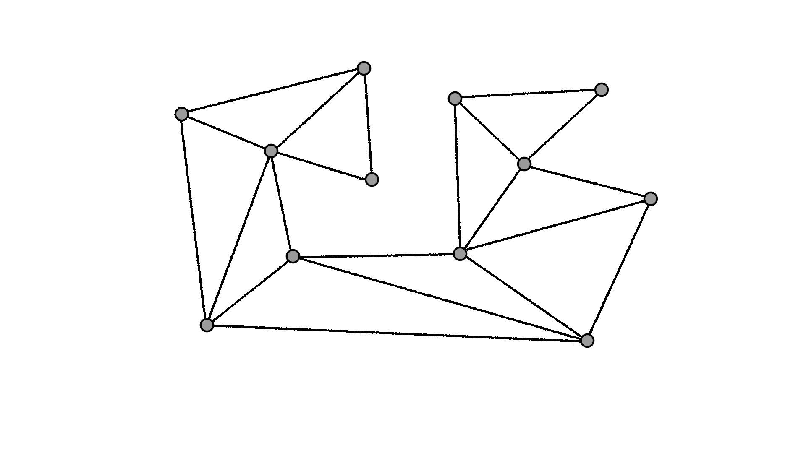
What does it mean to be 3-colourable?
The polygon can be triangulated.
Notes:
a polygon is 3 colorable, if it can be completely broken down into triangles, and the vertices of a resulting shape can be assigned a colour in such a way that no 2 vertices with the same colour are connected by an edge of a triangle

Slide 33
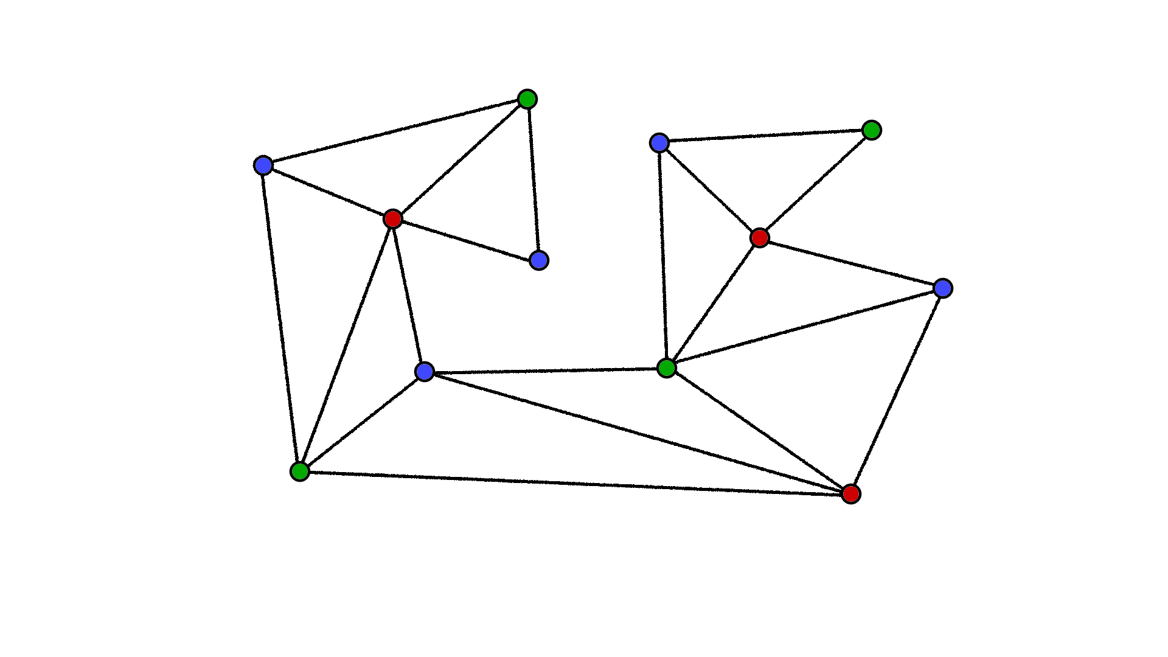
What does it mean to be 3-colourable?
2. Each vertex can be assigned one of three colours such that each triangle has a vertex of each colour
Notes:
a polygon is 3 colorable, if it can be completely broken down into triangles, and the vertices of a resulting shape can be assigned a colour in such a way that no 2 vertices with the same colour are connected by an edge of a triangle

Slide 34
What does it mean to be 3-colourable?
3. Each triangle has a vertex of each colour
Notes:
a polygon is 3 colorable, if it can be completely broken down into triangles, and the vertices of a resulting shape can be assigned a colour in such a way that no 2 vertices with the same colour are connected by an edge of a triangle

Slide 35
What does it mean to be 3-colourable?
In our case:
The polygon can be broken down completely into (V-2) triangles
Each vertex can be assigned a colour
No two vertices of the same colour are connected by an edge of a triangle
Notes:
a polygon is 3 colorable, if it can be completely broken down into triangles, and the vertices of a resulting shape can be assigned a colour in such a way that no 2 vertices with the same colour are connected by an edge of a triangle

Slide 36
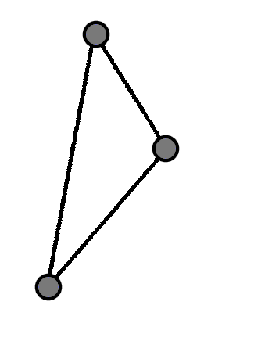
Base Case
Consider a polygon made of 1 triangle

Slide 37
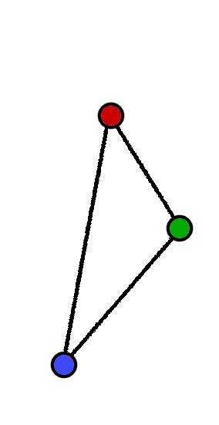
Base Case
Consider a polygon made of 1 triangle
Assign a different colour to each vertex - always 3-colorable

Slide 38
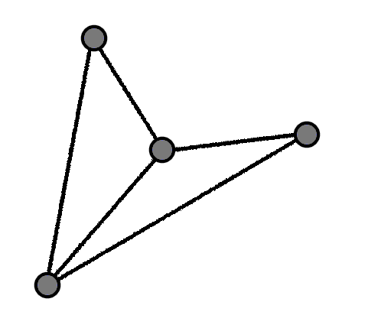
Next Case
Consider a polygon made of 2 triangles

Slide 39
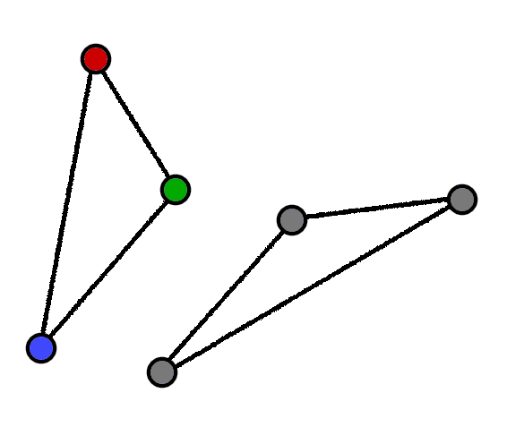
Next Case
Consider a polygon made of 2 triangles
Remove from it a polygon made of 1 triangle which we know is 3-colorable

Slide 40
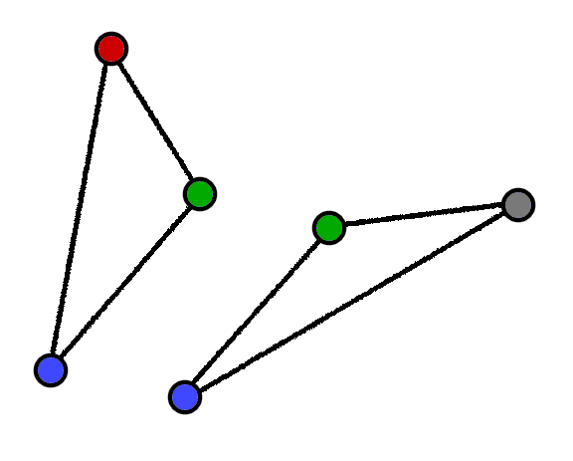
Next Case
Consider a polygon made of 2 triangles
Remove from it a polygon made of 1 triangle which we know is 3-colorable
For the remaining triangle - we must match the colour of the previously shared vertices

Slide 41
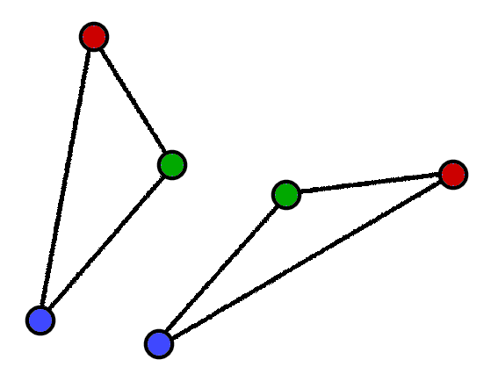
Next Case
Consider a polygon made of 2 triangles
Remove from it a polygon made of 1 triangle which we know is 3-colorable
For the remaining triangle - we must match the colour of the previously shared vertices
Assign a different colour to the last vertex

Slide 42
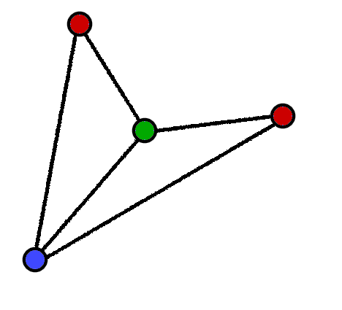
Next Case
Consider a polygon made of 2 triangles
Remove from it a polygon made of 1 triangle which we know is 3-colorable
For the remaining triangle - we must match the colour of the previously shared vertices
Assign a different colour to the last vertex
We can merge now to get a 3-colored polygon

Slide 43
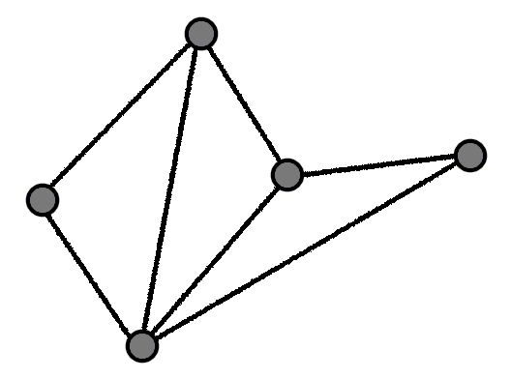
One more just to be safe
Consider a polygon made of 3 triangles

Slide 44
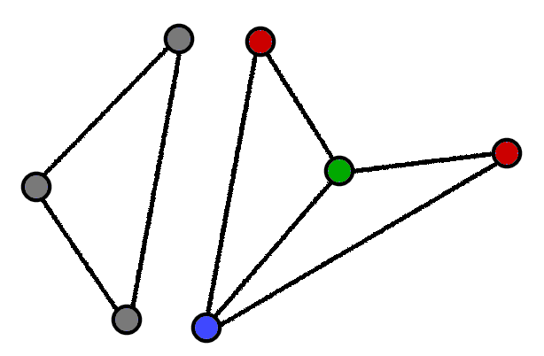
One more just to be safe
Consider a polygon made of 3 triangles
Remove from it a polygon made of 2 triangles which we know is 3-colorable

Slide 45
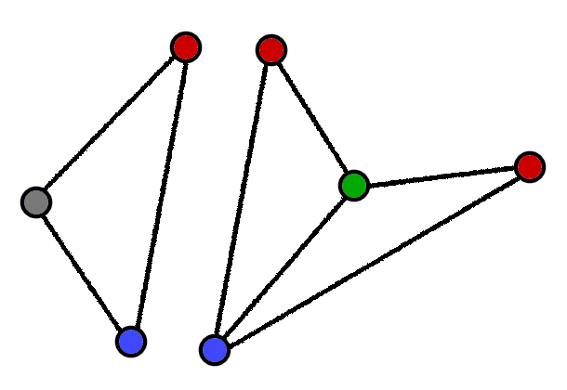
One more just to be safe
Consider a polygon made of 3 triangles
Remove from it a polygon made of 2 triangles which we know is 3-colorable
For the remaining triangle - we must match the colour of the previously shared vertices

Slide 46
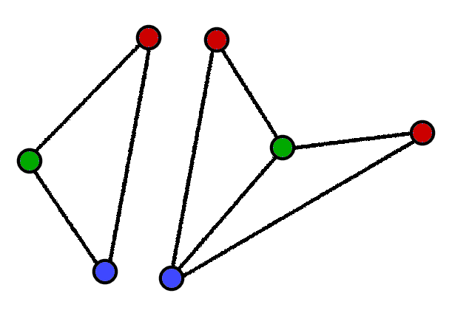
One more just to be safe
Consider a polygon made of 3 triangles
Remove from it a polygon made of 2 triangles which we know is 3-colorable
For the remaining triangle - we must match the colour of the previously shared vertices
Assign a different colour to the last vertex

Slide 47
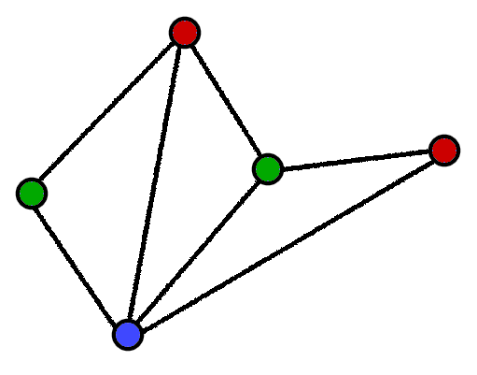
One more just to be safe
Consider a polygon made of 3 triangles
Remove from it a polygon made of 2 triangles which we know is 3-colorable
For the remaining triangle - we must match the colour of the previously shared vertices
Assign a different colour to the last vertex
We can merge now to get a 3-colored polygon

Slide 48
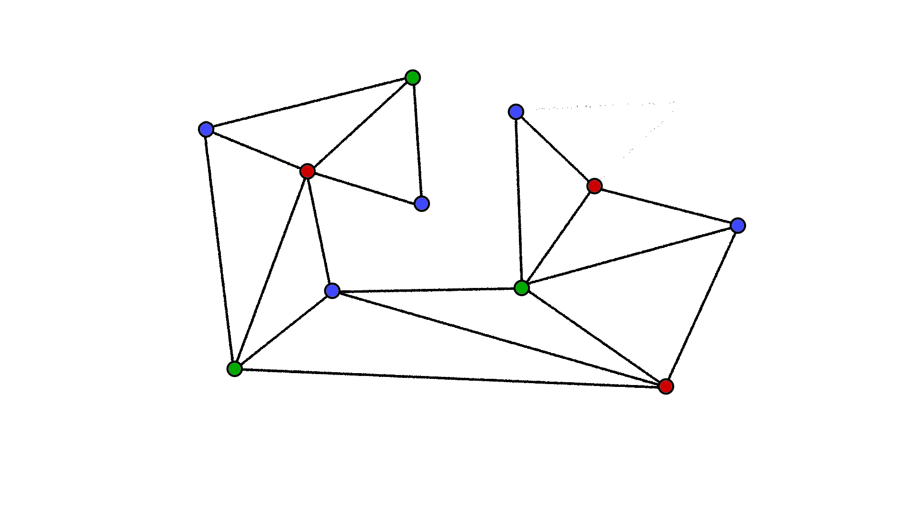
Inductive Hypothesis
Assume a Polygon made up of k triangles is 3-colourable

Slide 49
Inductive Step
Consider a polygon made of (k+1) triangles

Slide 50
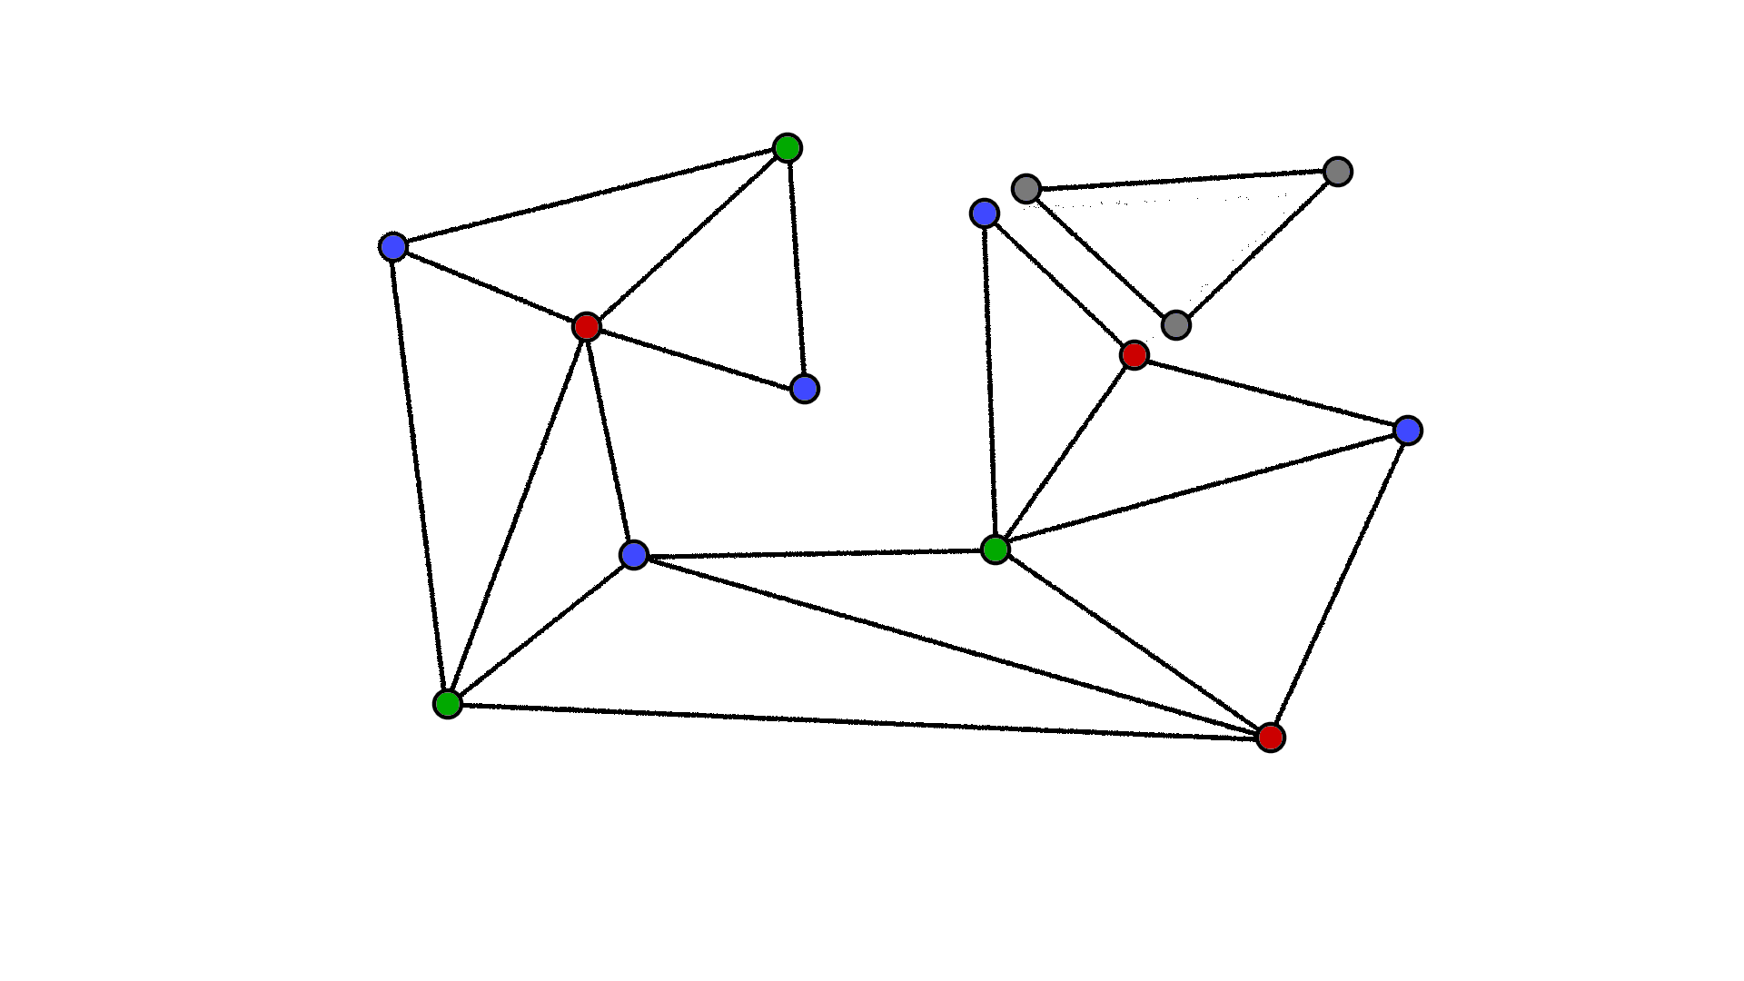
Inductive Step
Consider a polygon made of (k+1) triangles
Remove from it a polygon made of k triangles which we know is 3-colorable

Slide 51
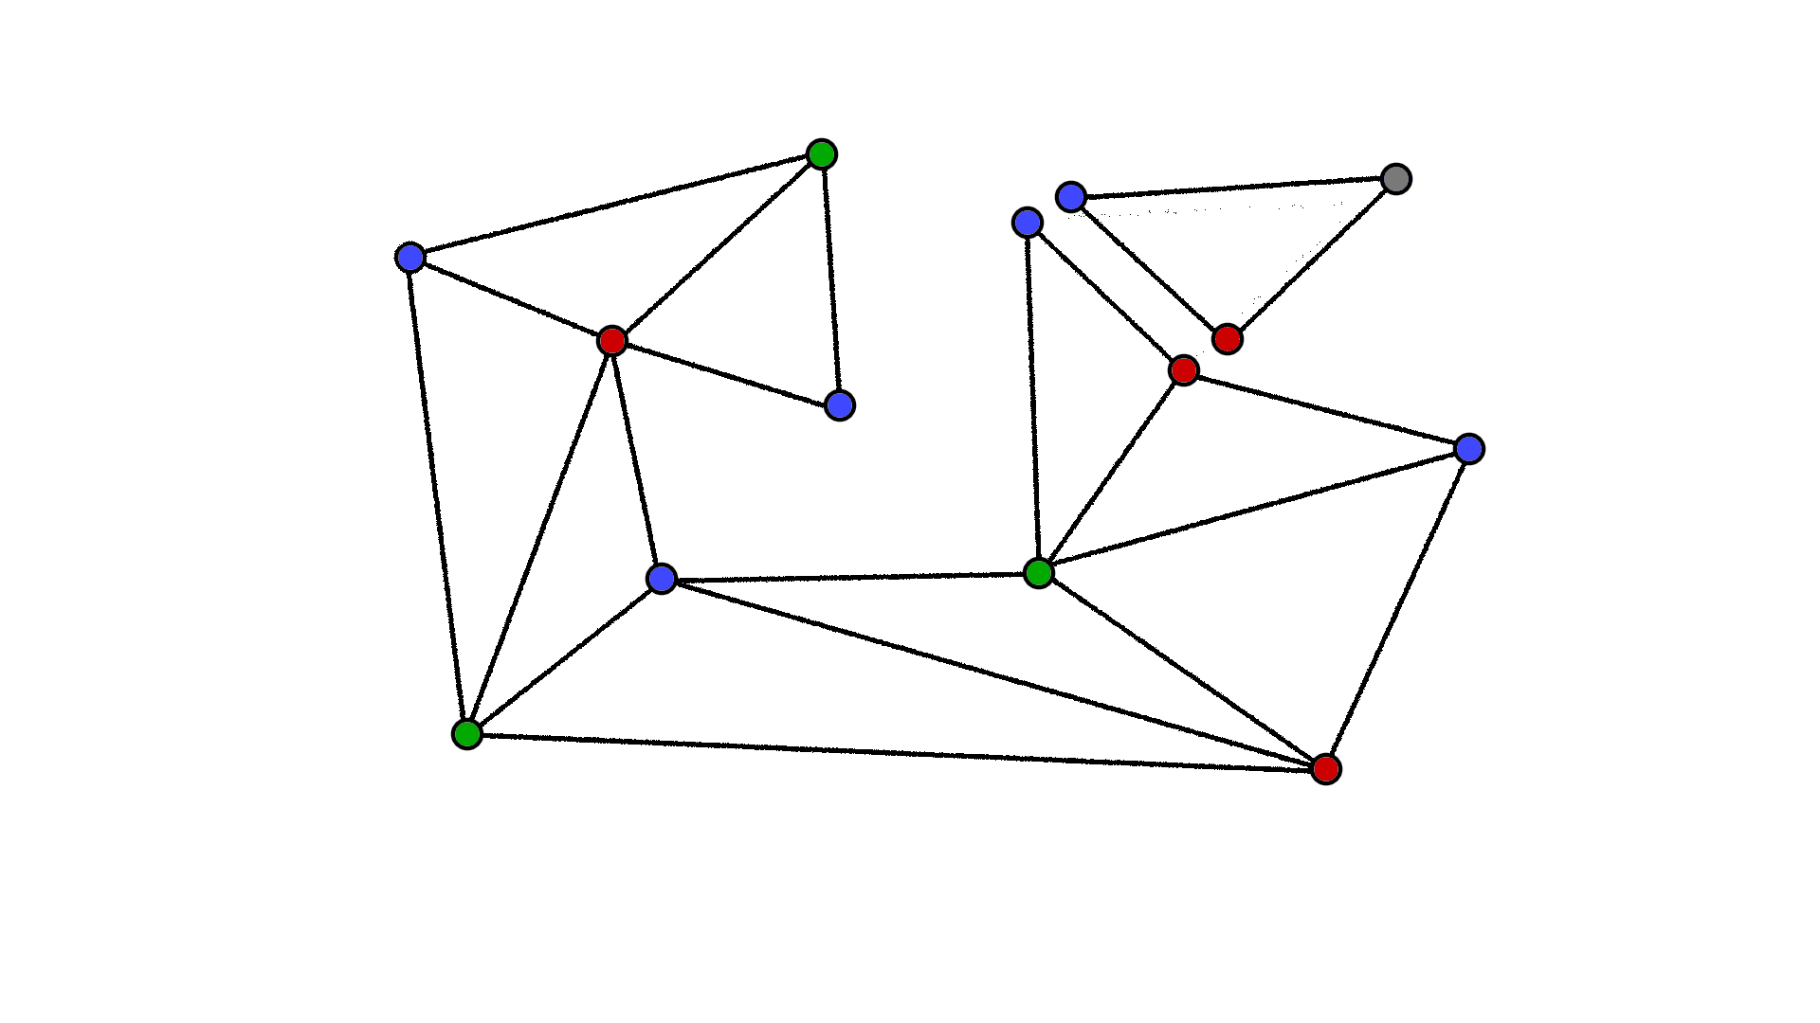
Inductive Step
Consider a polygon made of (k+1) triangles
Remove from it a polygon made of k triangles which we know is 3-colorable
For the remaining triangle - we must match the colour of the previously shared vertices

Slide 52
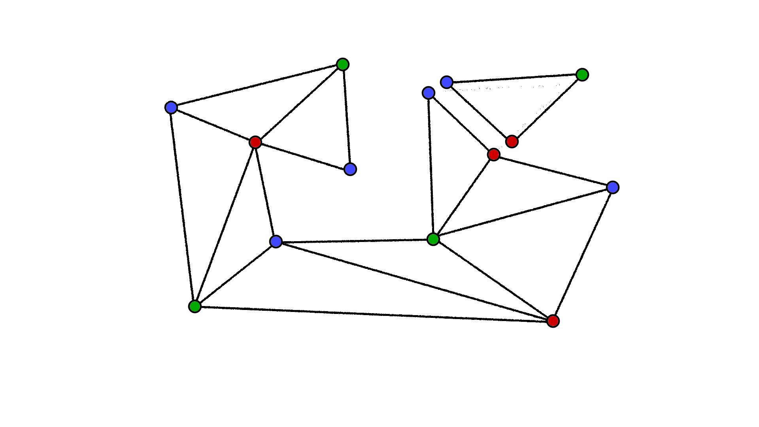
Inductive Step
Consider a polygon made of (k+1) triangles
Remove from it a polygon made of k triangles which we know is 3-colorable
For the remaining triangle - we must match the colour for the previously shared vertices
Assign a different color to the last vertex

Slide 53
Inductive Step
Consider a polygon made of (k+1) triangles
Remove from it a polygon made of k triangles which we know is 3-colorable
For the remaining triangle - we must match the colour of the previously shared vertices
Assign a different color to the last vertex
We can now merge to get a (k+1) coloured polygon

Slide 54
So any polygon that can be triangulated can also be 3-coloured

Slide 55
References
https://www.google.com/url?sa=i&url=https%3A%2F%2Fbrilliant.org%2Fwiki%2Fguarding-a-museum%2F&psig=AOvVaw1h7KC5ArVm2Zi113OmfAoo&ust=1681110264998000&source=images&cd=vfe&ved=0CBEQjRxqFwoTCJiHwvOdnP4CFQAAAAAdAAAAABAE
https://isovist.art/img/posts/helloworld/art-gallery-problem.png

